Slide 1

Inception Net (GoogLeNet)

Slide 2
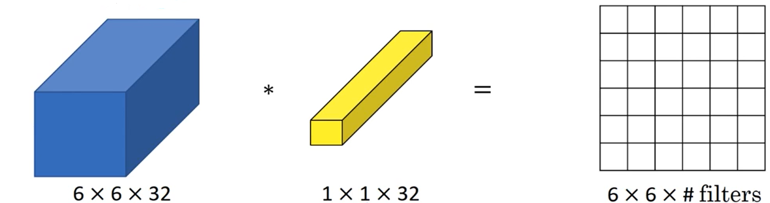
1x1 Convolution
If you want to keep same dimensions of the input while reducing the depth
  Use same convolution and a number of filters less than input depth
  Or
  Use 1x 1 convolution

Slide 3
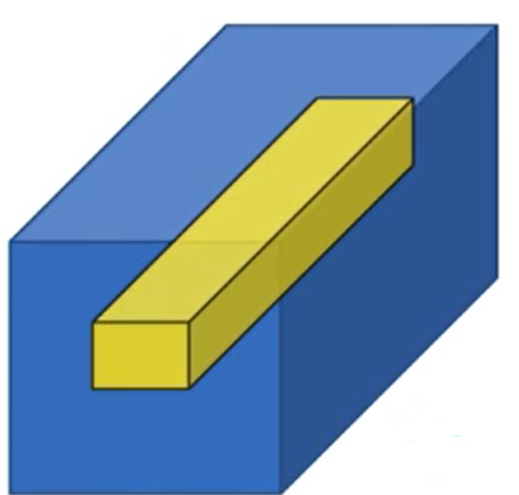








Activation function on a linear combination of 32 numbers
$$w_{32}$$
$$w_{2}$$
$$w_{1}$$
$$w_{1}$$
$$32\left\{\begin{matrix}\begin{matrix}\begin{matrix} \\ \\ \end{matrix} \\ \\ \end{matrix} \\ \\ \end{matrix}\right.$$
$$32\left\{\begin{matrix}\begin{matrix}\begin{matrix} \\ \\ \end{matrix} \\ \\ \end{matrix} \\ \\ \end{matrix}\right.$$
$$w_{2}$$
.
.
.
Adding more filters →
.
.
.
$$w_{32}$$
Network in Network

Slide 4
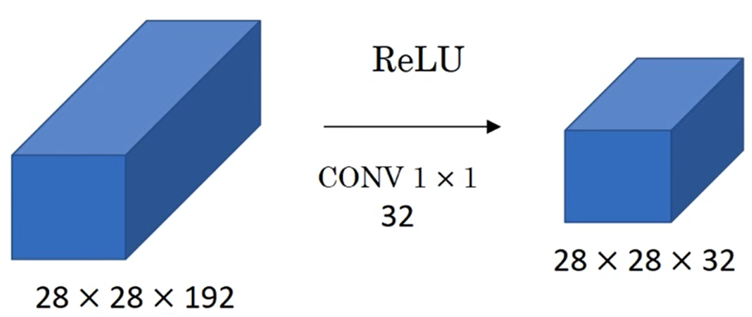

To sum up
$$\text{each} \text{filter} \text{size}\text{: 1}×1×192$$

Slide 5
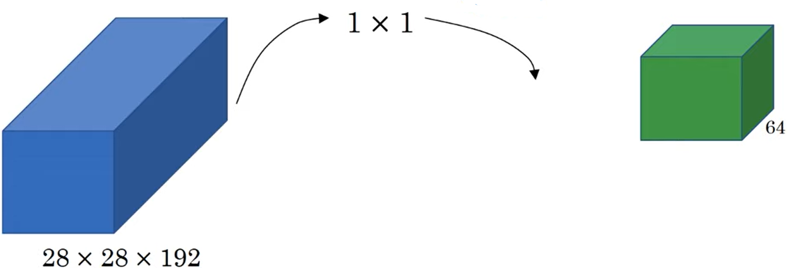
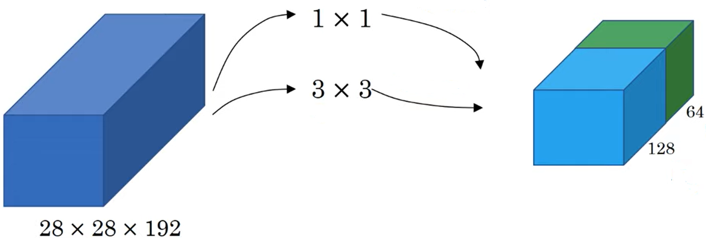
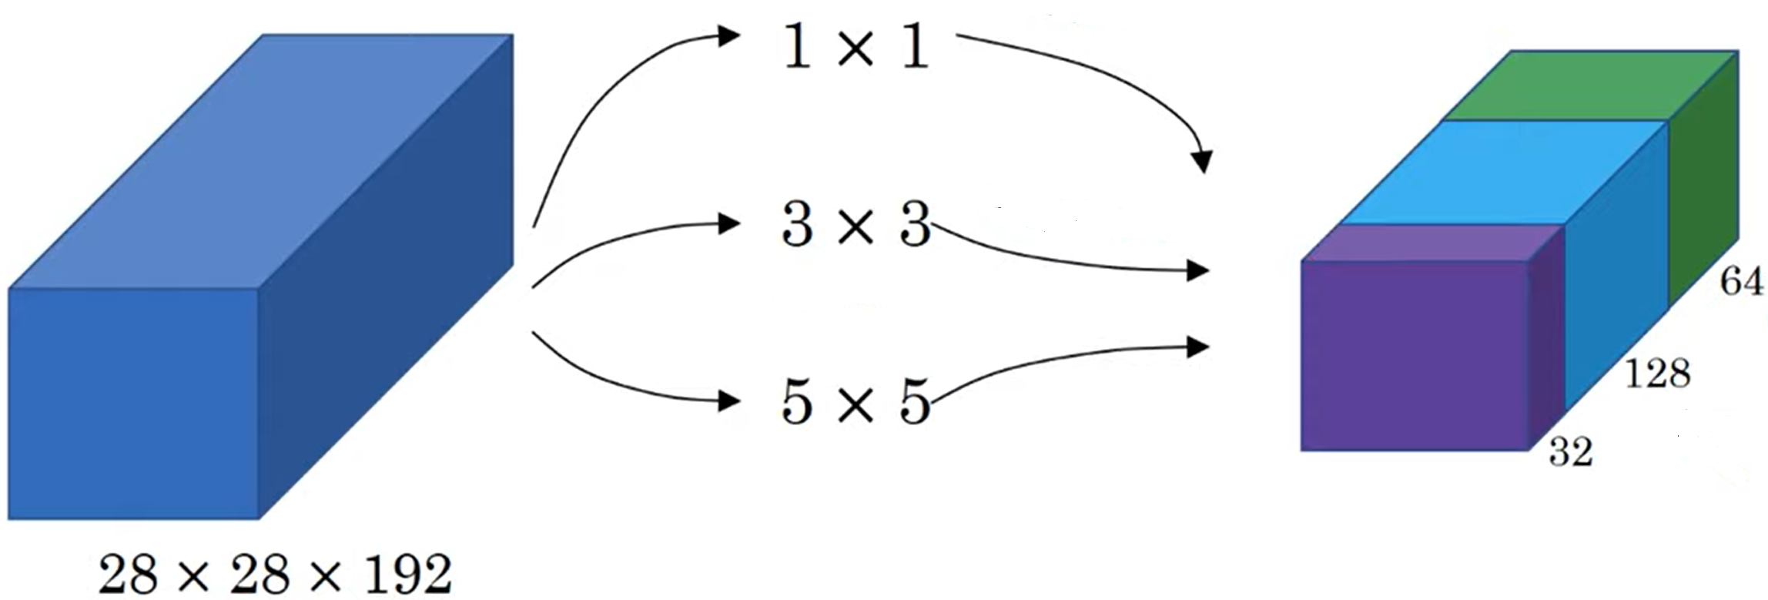
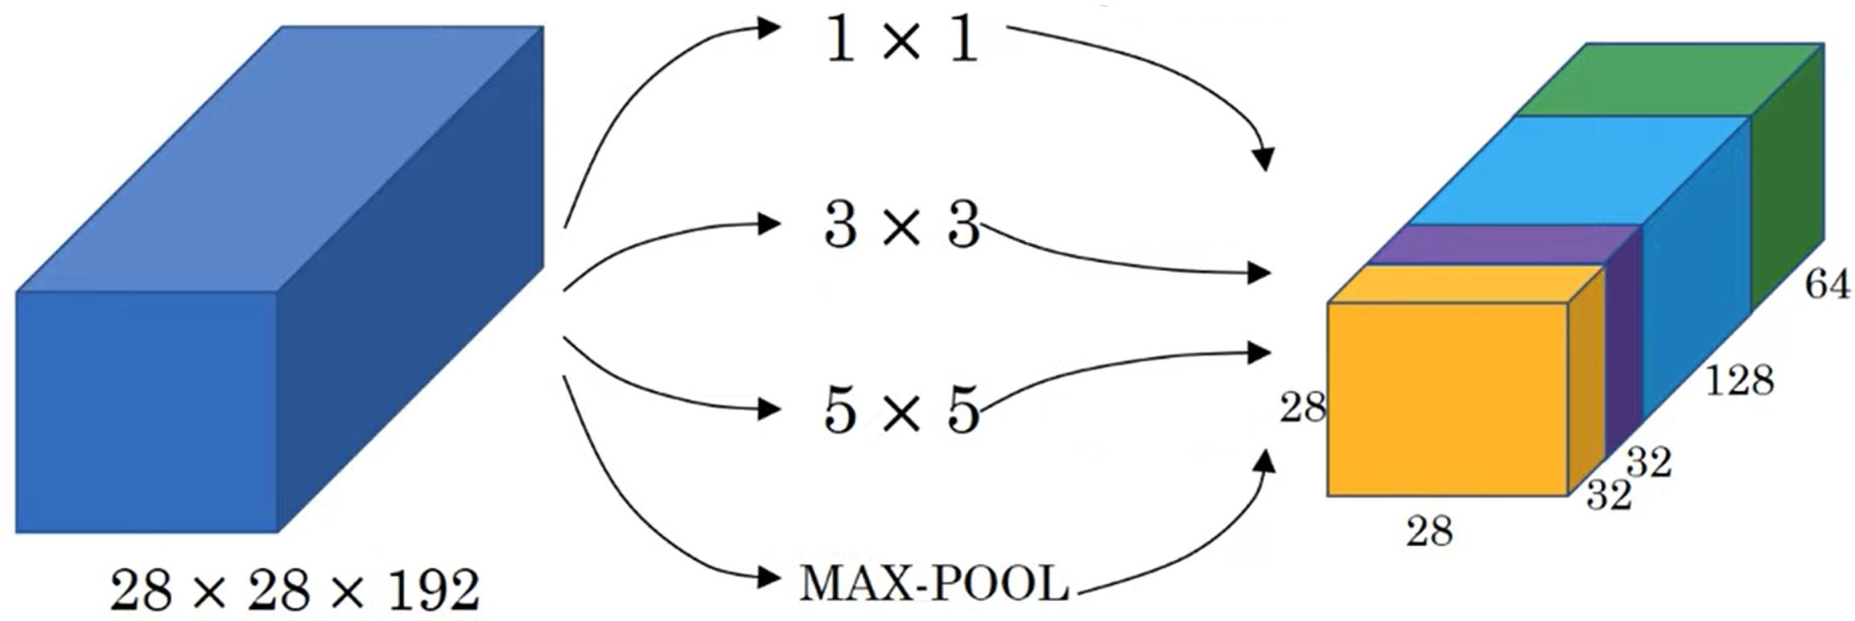






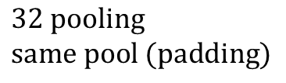
Inception module
$$64 \text{filters}$$
$$128 \text{filters} \\ \text{same} \text{conv}$$
$$128 \text{filters} \\ \text{same} \text{conv}$$
$$128 \text{filters} \\ \text{same} \text{conv}$$
$$32 \text{filters} \\ \text{same} \text{conv}$$
$$32 \text{filters} \\ \text{same} \text{conv}$$
$$32 \text{pooling} \\ \text{same} \text{pool}\text{ (}\text{padding}\text{)}$$
$$28×28×192⟶28×28×256$$
Notes:
Max pool same implica che si fa padding in modo che output abbia stessa dim input (es: input 4x4 pool 2x2 stride=1 padding-> input 5x5

Slide 6
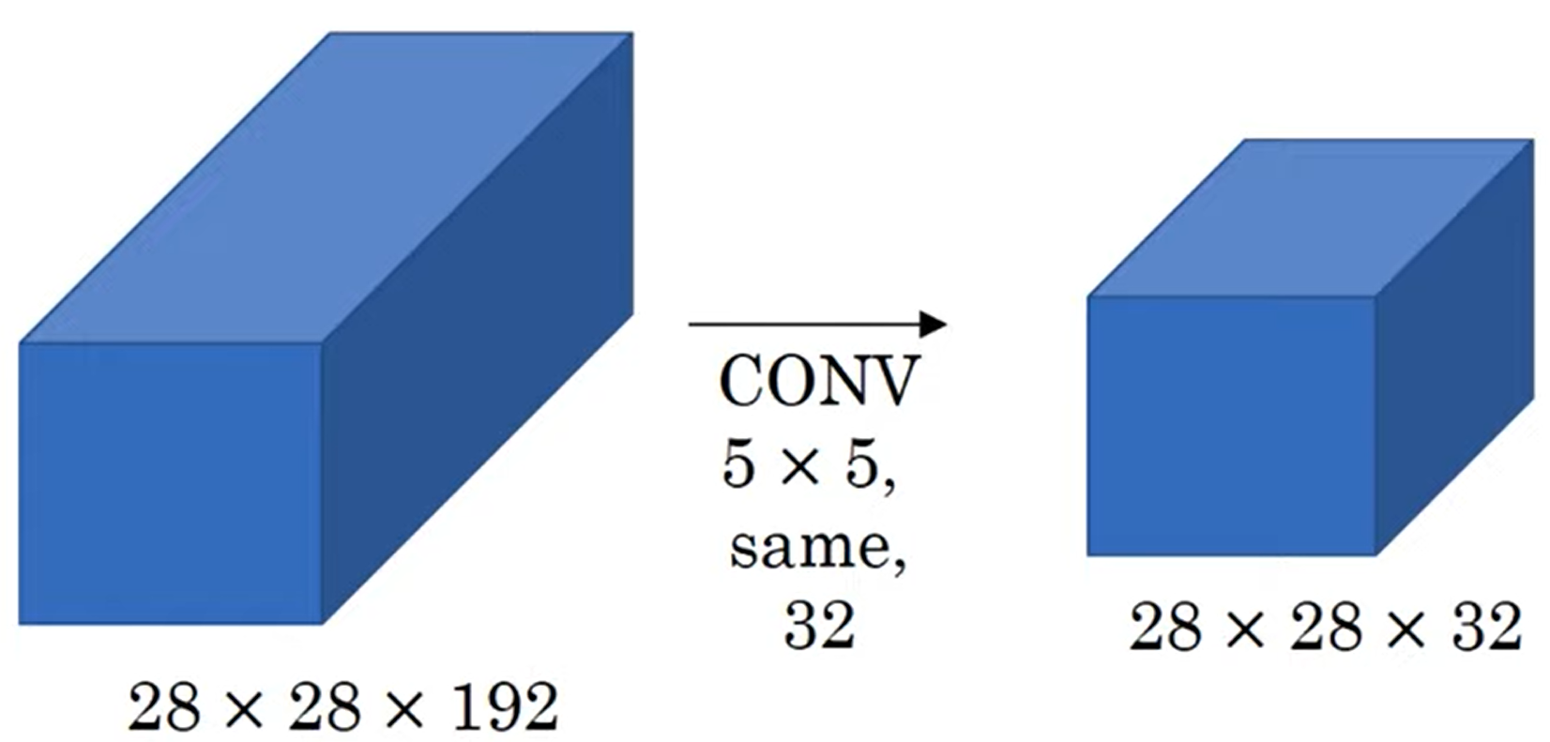
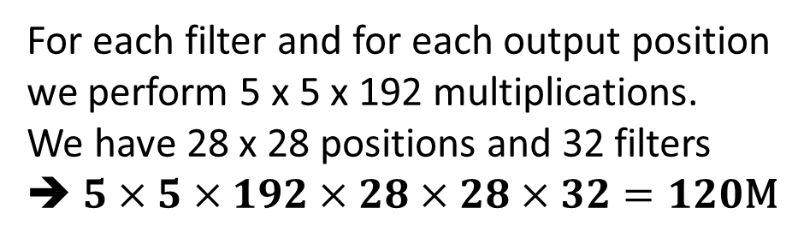
The problem of computational cost
For each filter and for each output position
we perform 5 x 5 x 192 multiplications.
We have 28 x 28 positions and 32 filters
➔ $5×5×192×28×28×32=120\text{M}$
By using 1x1 convolution we can reduce the cost
by a factor of 10

Slide 7
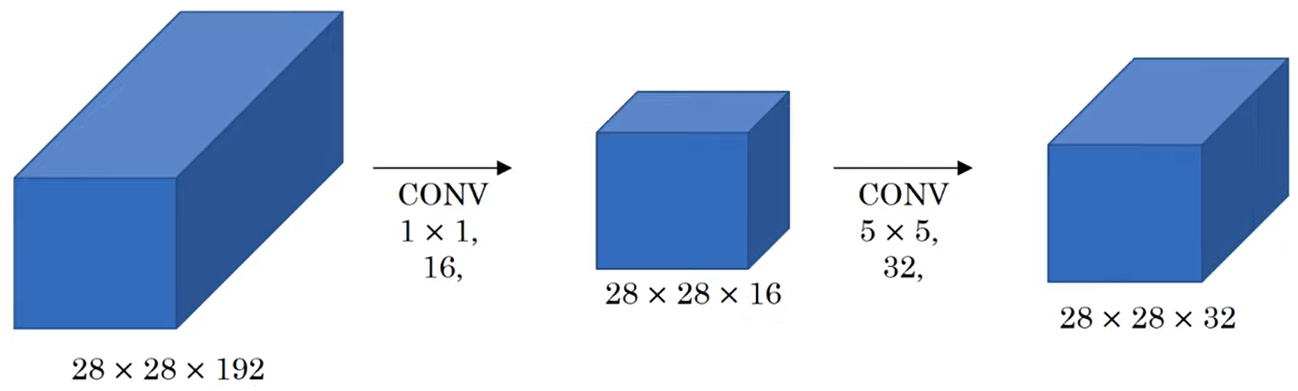

1x1 Convolution to the rescue
bottleneck layer
$$\left(5×5×16\right)×\left(28×28×32\right)=10\text{M}$$
$$\left(1×1×192\right)×\left(28×28×16\right)=2.4\text{M}$$
$$\text{Total}:12.4\text{M}$$

Slide 8
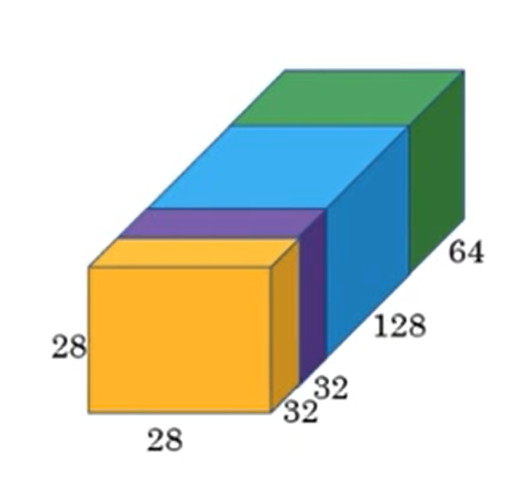
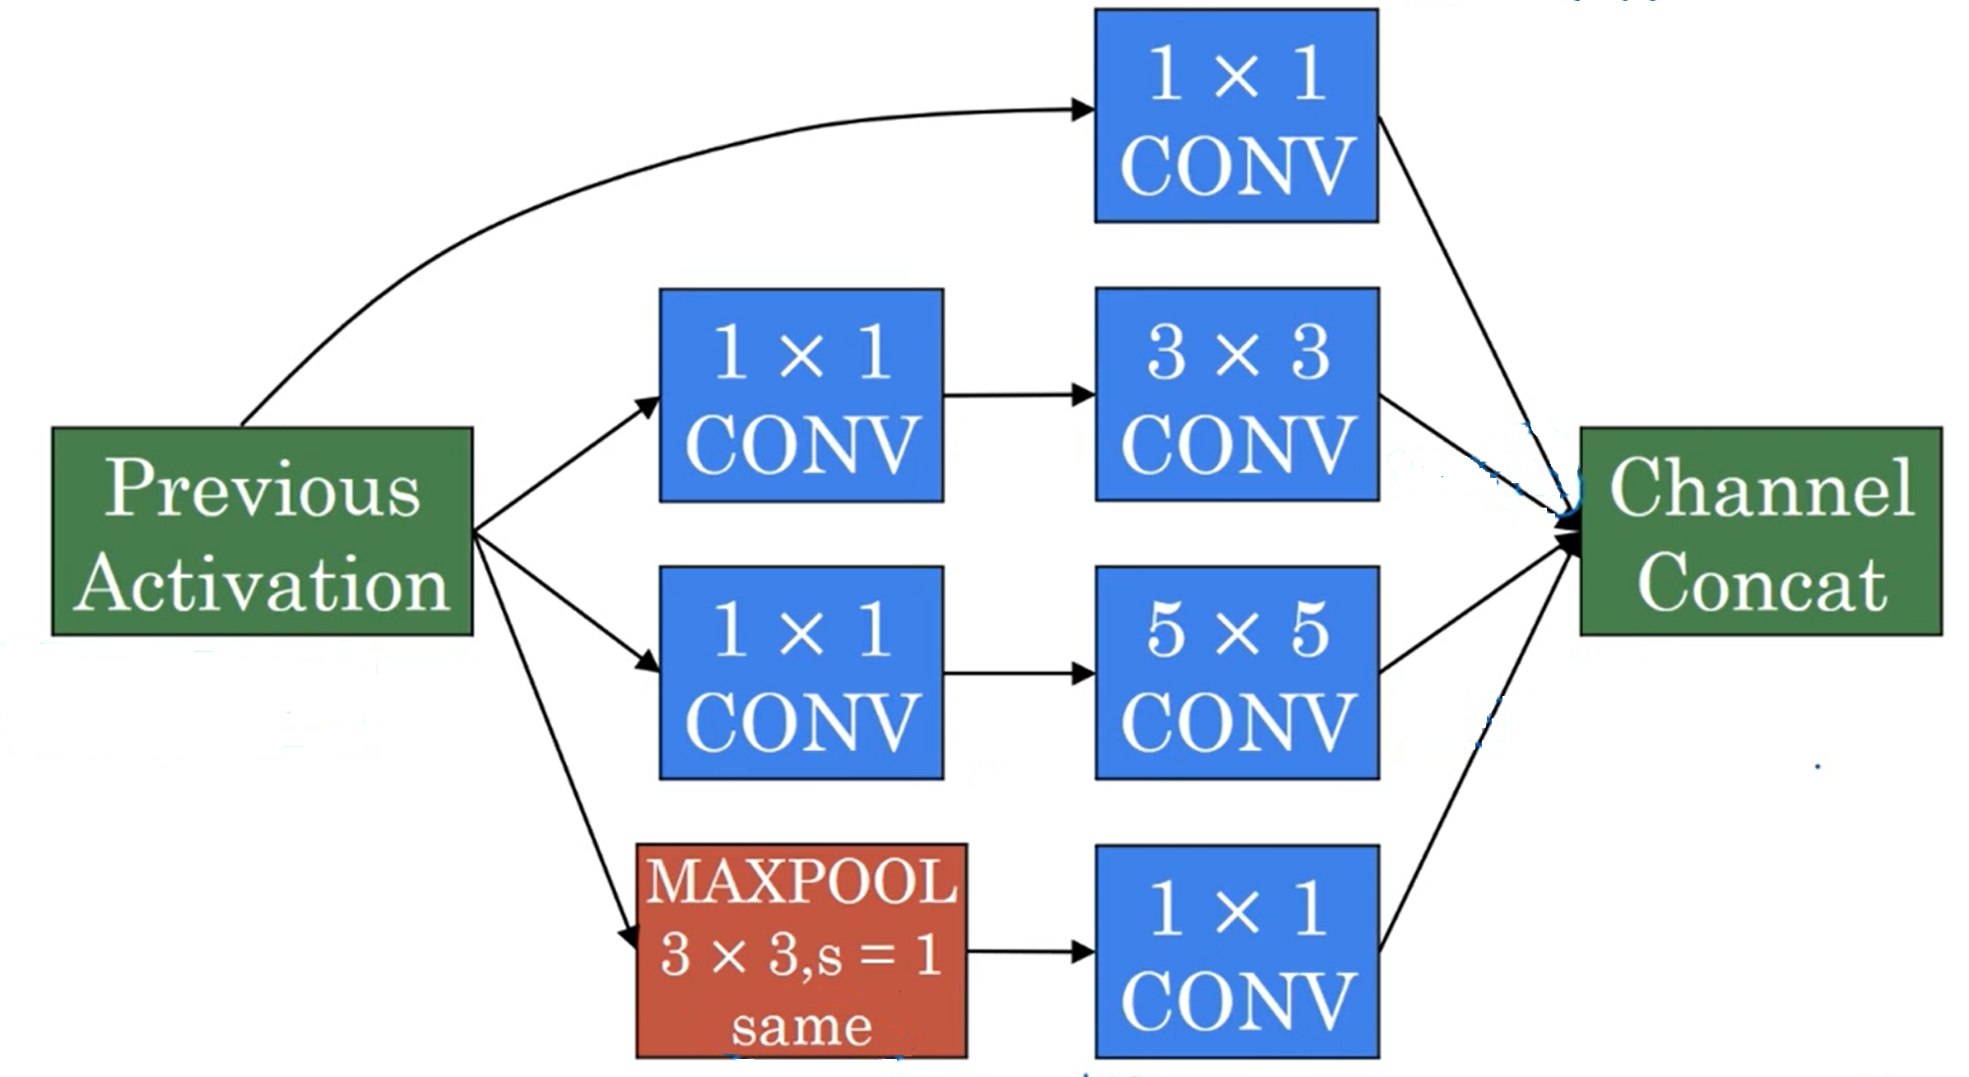














Inception module
64
$$28×28×64$$
$$128$$
$$96$$
$$28×28×96$$
$$28×28×128$$
$$16$$
$$32$$
$$28×28×192$$
$$28×28×256$$
$$28×28×16$$
$$28×28×32$$
$$32$$
$$28×28×192$$
$$28×28×32$$

Slide 9
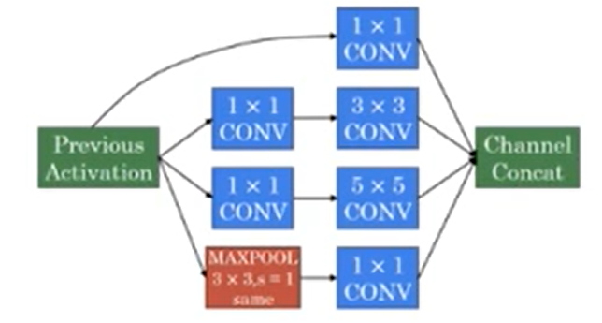
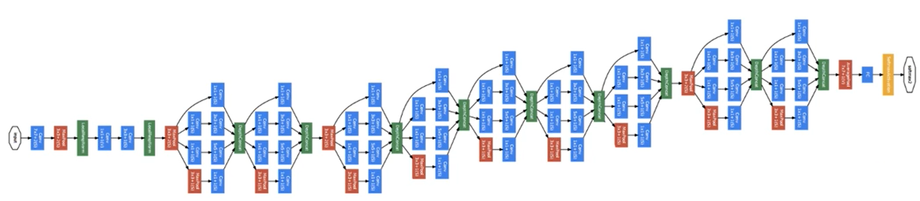
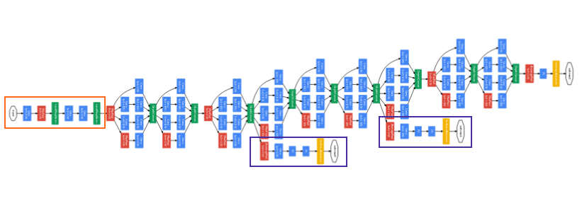
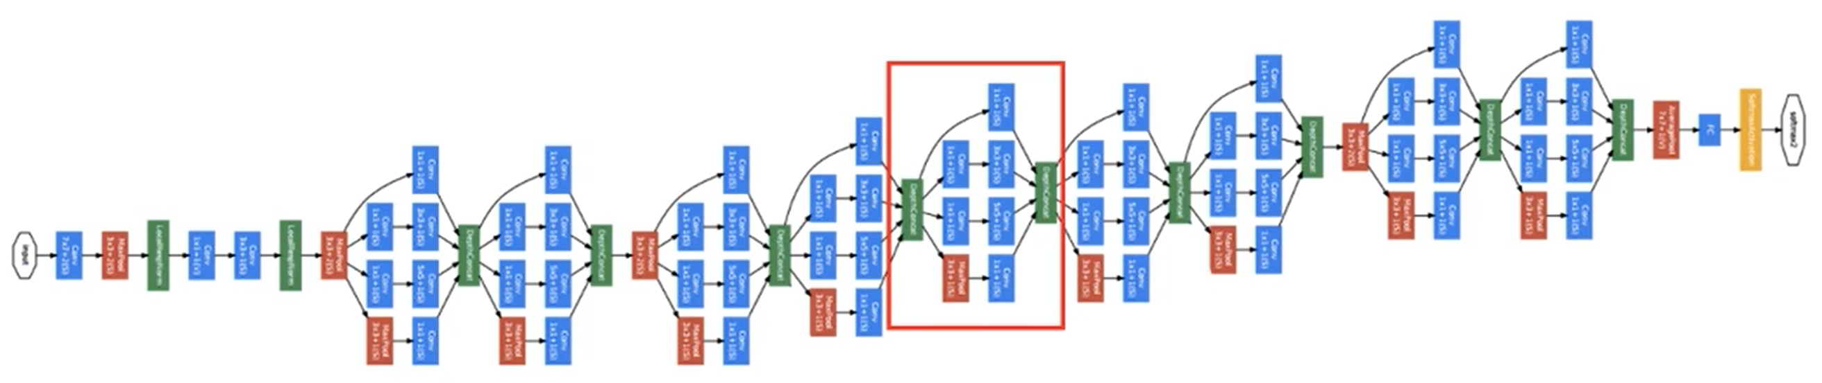
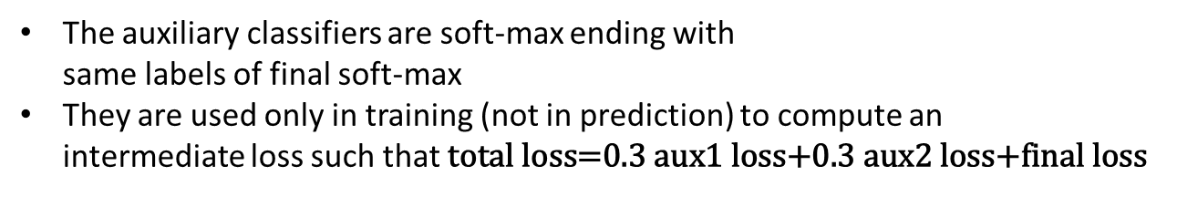
Inception net (GoogLeNet)
Max pool connection
between inception modules
Preliminary convolutions
The auxiliary classifiers are soft-max ending with
same labels of final soft-max
They are used only in training (not in prediction) to compute an
intermediate loss such that $\text{total} \text{loss}\text{=0.3 }\text{aux}\text{1 }\text{loss}\text{+0.3 }\text{aux}\text{2 }\text{loss}\text{+}\text{final} \text{loss}$
Auxialiary classifiers

Slide 10
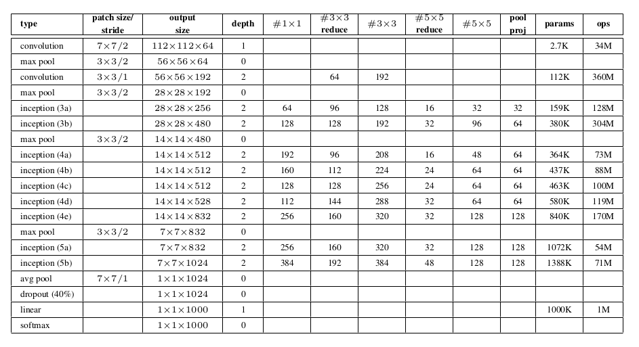
Details

